Slide 1
C++
By
M.Kharatizadeh(Arcana) @li

Slide 2
Topics
String
Vector
List
Algorithms

Slide 3
string
String Creation
Appending
Functions
Formatting

Slide 4
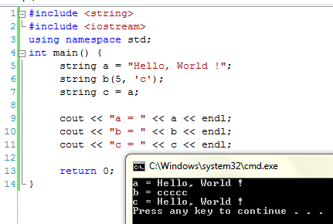
String creation

Slide 5
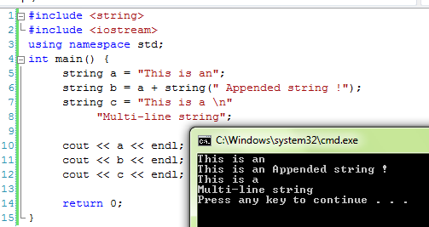
String appending

Slide 6
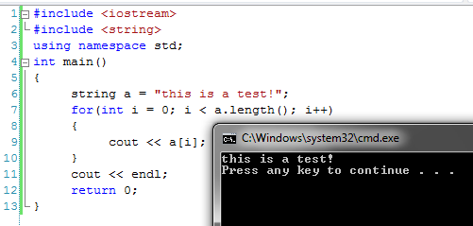
String functions

Slide 7
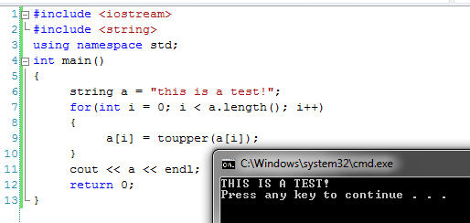
String functions

Slide 8
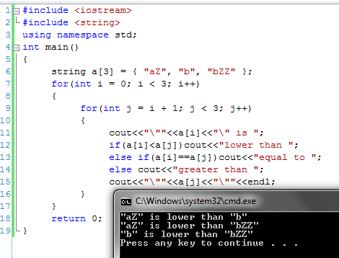
String functions

Slide 9
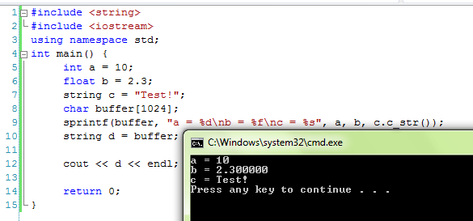
String formatting

Slide 10
String formatting
sprintf(
targer_character_array, formatt_string, parameter(s))

Slide 11
String formatting
%d integers
%f real values(double)
%s strings
%c characters
%x, %X hexadicimal intgers

Slide 12
String formatting
Example
%.2f
Rounds the real number to two digits after the decimal point !

Slide 13
Topics
String
Vector
List
Algorithms

Slide 14
vector
Fast AND Efficient !
Like a resizable array !
Resizes it-self as you add elements to it !
You can resize it when you feel necessary !
Checks boundaries so that you do not cross array range accidentally !
NOTE : Only adds to the end of the list efficiently, use list instead if you want to add to the beginning !

Slide 15
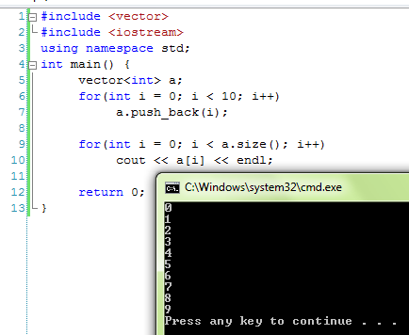
vector

Slide 16
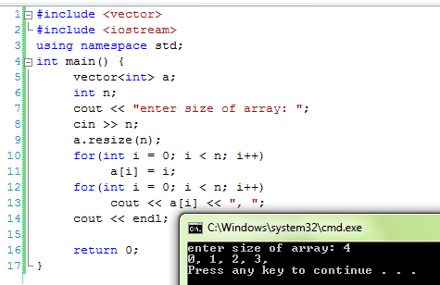
vector

Slide 17
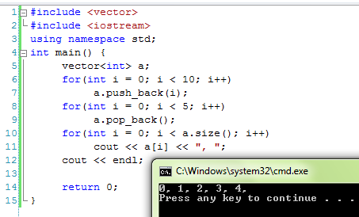
vector

Slide 18
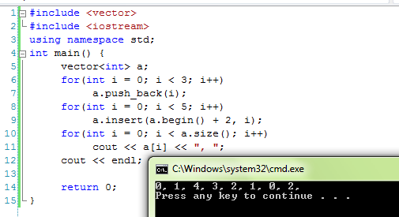
vector

Slide 19
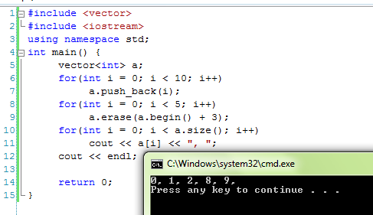
vector

Slide 20
Topics
String
Vector
List
Algorithms

Slide 21
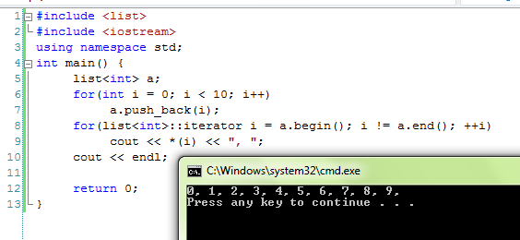
list

Slide 22
Topics
String
Vector
List
Algorithms

Slide 23
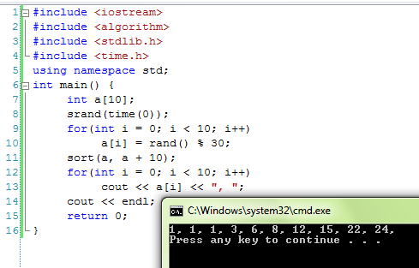
algorithms

Slide 24
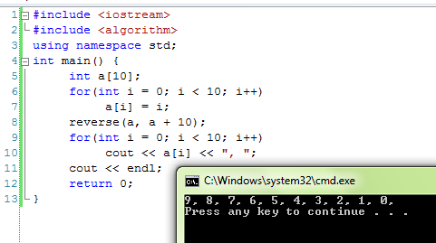
algorithms

Slide 25
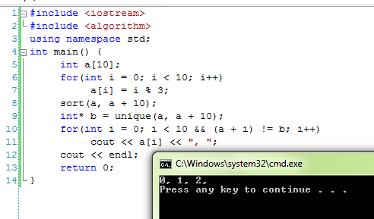
algorithms

Slide 26
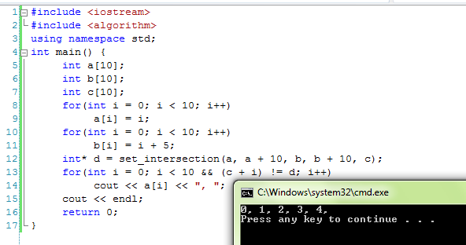
algorithms

Slide 27
algorithms
set_difference
set_union
search
search_n
......

Slide 28
Questions ?

Slide 29
You can download this slide from:
Alisahaf70.persiangig.com/slide

